Slide 1
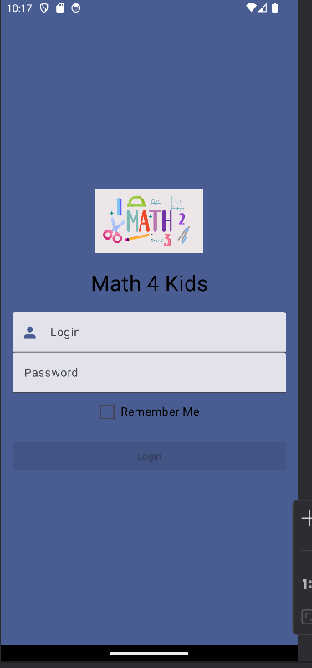
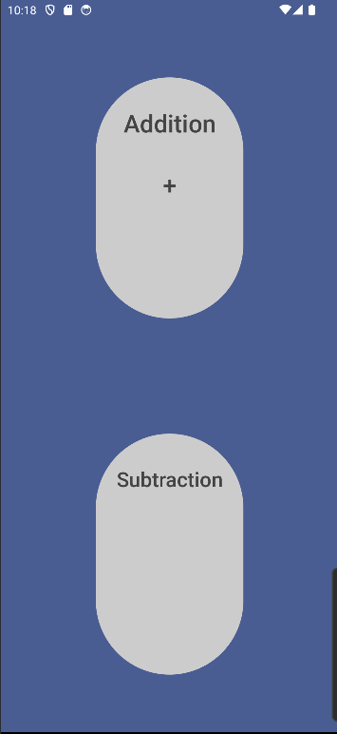
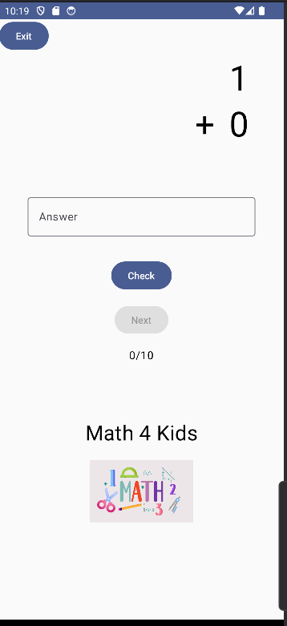
Android Studio App Development
Math 4 Kids
Background: Math 4 Kids is an app that test children’s additions skills through randomized flashcards.
Login Screen: The login screen shows a username and password box, along with a login button.
Select Screen: The select screen allows users to select the addition game which will bring them to the addition game.
v
v
v
Game Screen: The game screen shows a flashcard that test the user’s addition skills. Once the user answers, checks their answer, and clicks the next button, the flashcards randomize.
Malakhi Griffin, Alyssa Khoury, Dana Rose

Slide 2
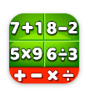

About our mobile application…
We built our mobile application to help kids test their math skills.
By randomizing math problems for children to try, their knowledge will grow
We also take interest in math
A couple of similar apps:
Math Kids: Math Games For Kids
Math Games: Math for Kids
Challenges:
Navigation
Randomization of flashcard
Error Handling/Edge Cases
Failures:
Adding more math challenges (multiplication/division)
Successes:
Login Screen
Check answer function
Learnings:
If applicable, replicate your code based on other people’s code that may have done the same thing
Mobile Application development process

Slide 3
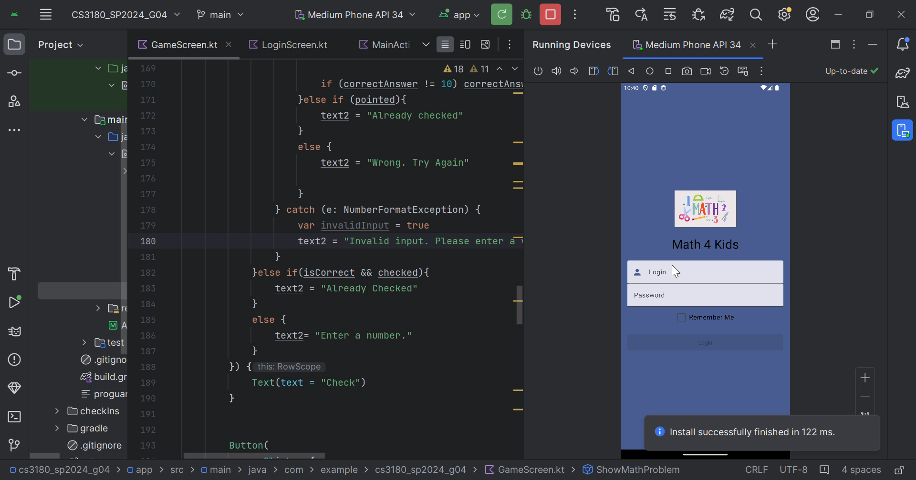
Video:

